Slide 1
National Council on Federal Labor-Management Relations BEP Employee Engagement Improvements
March 19th, 2014
Chris Mahoney, Chairman of the Joint Labor Council
Will Levy III, Associate Director (Management) & CIO

Slide 2
Bureau of Engraving and Printing Background
150+ year history of printing the nation’s currency
Approximately 1,850 employees
Manufacturing environment
2 facilities
Washington D.C.
Fort Worth, TX.
Non-appropriated. Funded by the Federal Reserve Board to cover costs associated with design and printing of notes.
Heavily unionized environment
15 unions
19 bargaining units
18 labor contracts
Joint Labor Council (JLC) that represents leadership of all unions
Monthly Executive and JLC meeting

Slide 4
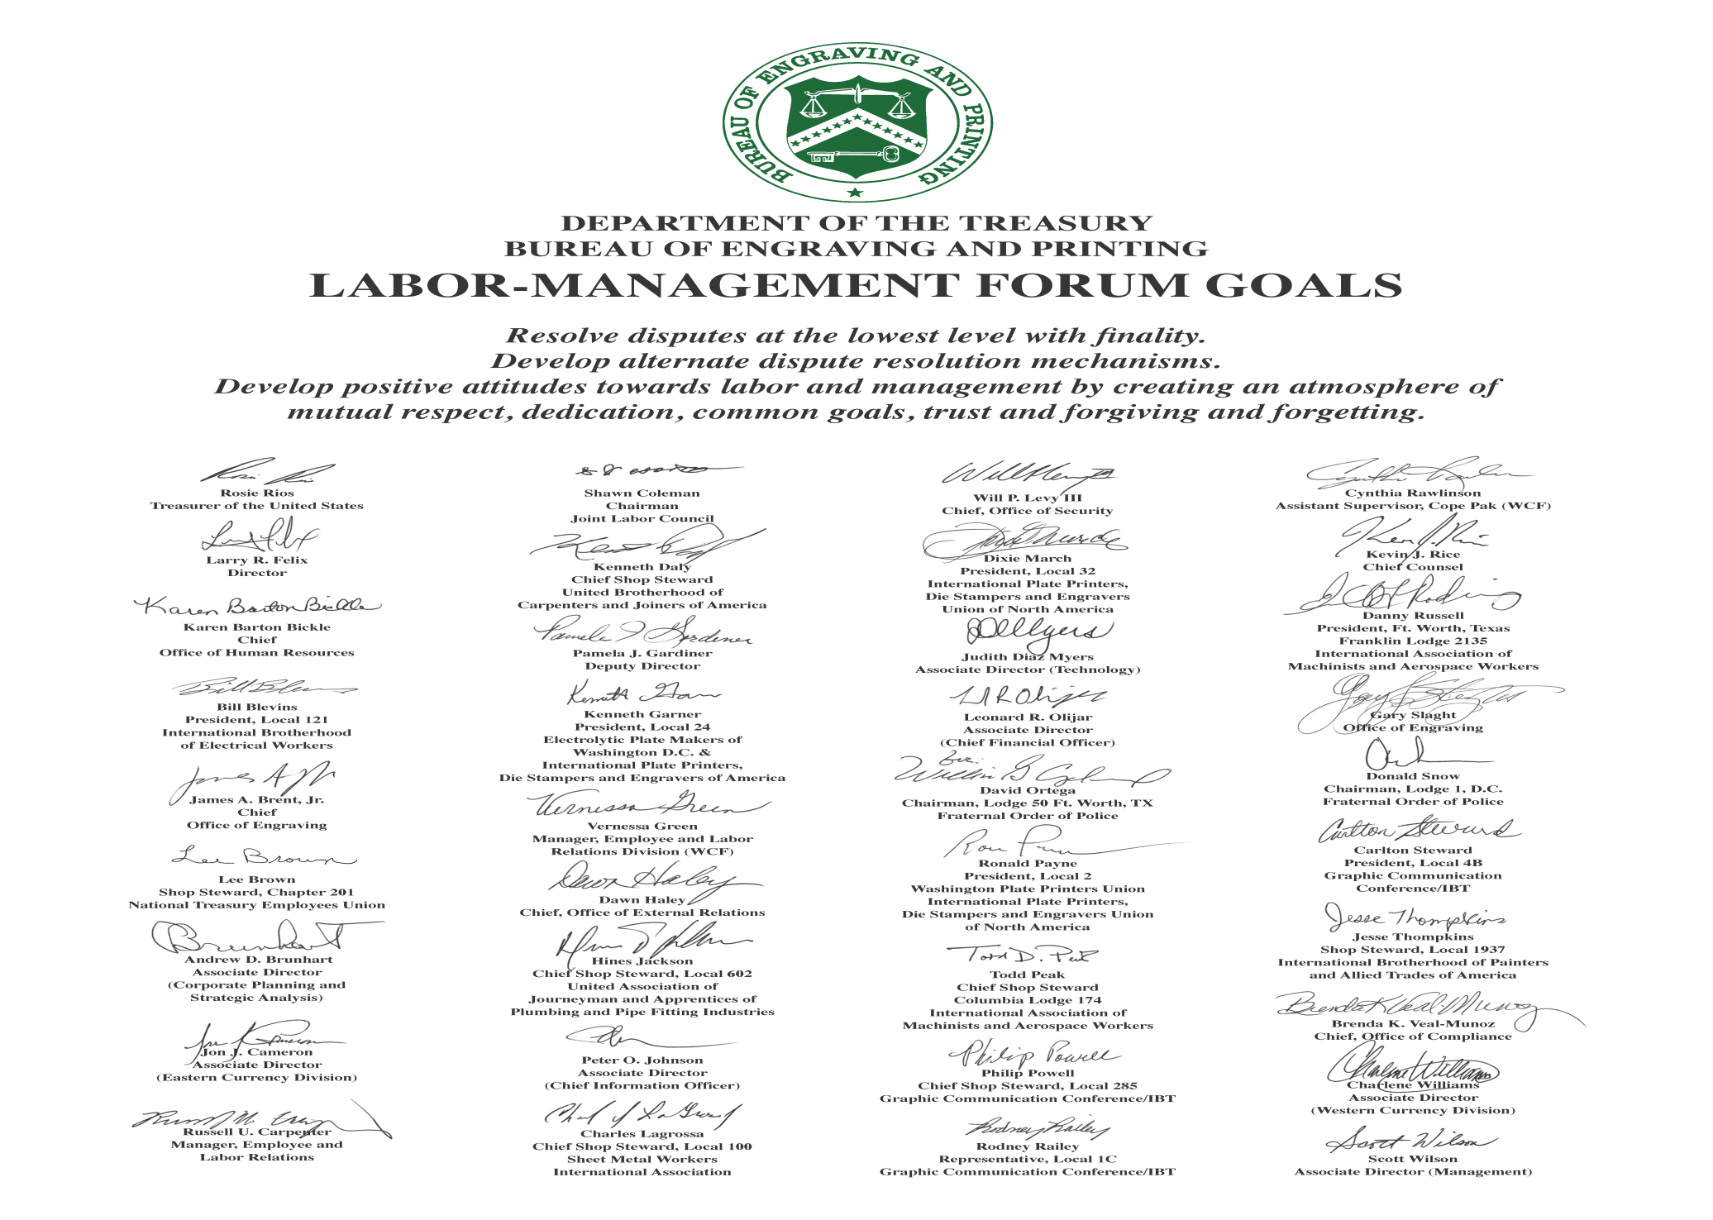

Slide 5
BEP “Best Places to Work” Ranking (2007-2013)

Slide 6
BEP Ranking & Index data (2003-2013)
Normalized for the number of Agencies in the Survey

Slide 7
BEP Employee Engagement Goals
Drive employee engagement and empowerment through a dedicated journey (long term effort and improvements year over year - with some quick fixes)
Do the right thing for the BEP and as a result, improve our BPTW ranking (major strategic goal)
Improve accountability at all levels
Improve supervisory and leadership skills at all levels
Instill the BEP Core Values
Integrity, Fairness, Performance and Respect
Become a World Class Organization (as we defined it) focused on customer service and high quality
Pre-decisional involvement of labor before key policy decisions are made

Slide 8
BEP Employee Engagement Improvement Journey
Mini-surveys conducted to monitor employee satisfaction
Frequent Engagement-based Communications
Accountability Gauntlet laid down
2015
Numerous Coaching & Mentoring sessions held
Fort Worth-Specific Motivational Initiative
2014
Leadership & Engagement Training Completed
Focus on FEVS Indices
2013
Internal (FEVS Based) Survey
Implemented Coaching & Mentoring Program
DC-Specific Motivational Initiative
Roadshow II conducted
2012
First Improvements Implemented
Implemented “Aim 4 Yes!”
Motto, Credo, etc.
Employee Roadshow I completed
2011
Focused BPTW Branding begins
Focus Groups Conducted in conjunction with labor leaders
2010
Consultant report issued
Hired Work-life Coordinator
Employee Engagement Plan Approved and concurred
with by labor leaders
2009
BPTW Strategic Initiative Created by the Director
Notes:
Here the speaker just needs to step through the various events on the timeline.
Mar 10, Explain that we conducted over 15 focus groups with 200+ people
Apr 10, emphasize the public release of the contractor report and mention that was part of the “transparency” we committed to.
Jun 10th, emphasize the Union/BPTW offsite where we validated and finalized the recommendations as a group
Nov 10, EVS Action Plan going to Treasury had JLC review/concurrence prior to being sent.
Dec 10, KAREN LIST SOME DUTIES HERE OF KRISTIN. PEOPLE DON’T KNOW WHAT A WORKLIFE COORDINATOR DOES…
Also on Dec 10th re-emphasize release of the EVS plan to all

Slide 9
BEP Motto
Customers First, Quality Always…

Slide 10
BEP Credo
As BEP employees, we believe nothing is more essential than providing excellent customer service and world-class products. Whether we are on the production floor or in the executive suite, much is expected. We must do everything in our power to demonstrate the BEP core values of Respect, Fairness, Integrity, and Performance in our actions, decisions, and interpersonal relationships.
As users of United States currency, the world is our ultimate customer. We are responsible to ensure everything we do contributes to developing and producing currency that meets our customers’ quality standards and can be counted on to be accepted and secure in all cash transactions.
We are committed to helping one another fulfill professional and personal obligations and with supporting each other to be creative, make effective decisions, share ideas, and enjoy the work experience.
Each person who we come into contact with must go away feeling that we listened well and addressed their needs in a timely, appropriate, and helpful way.
Lastly, in order to become the World Class organization that we strive to be, we are all accountable to follow this Credo.

Slide 11
Focus Group Hallmark Statement
Throughout the focus group meetings, many recommendations dealt with “accountability.” In many areas (e.g. hiring, discipline, rewards), policies and procedures are in place for how things should be done.
Repeatedly, focus group participants cited instances when those with management authority (Supervisors to ADs) did not follow the policies and procedures and there were no consequences and these inappropriate
actions continue, i.e. there is no accountability.
Without support and action by the Director to change this culture and
ensure that these situations are not allowed to continue,
there is little confidence that improvements will be made in
how the Bureau is seen as a better place to work.
Notes:
I’d pause here for 90 seconds (I timed it) then say this statement comes from the final employee focus group of approximately 20 people.
After we did the 15ish groups, recall they gave us many non-actionable recommendations. We formed this final group to flesh them out. They came to the conclusion that NO MATTER WHAT WE DO, if we don’t fix accountability issues, things will not improve.
This statement is word for word from that group. While the words might seem to focus on following policy, during discussion they were heavily focused on managers not be held accountable for poor performance or treatment of employees and, not equally to employees.
It is important to note here that one issue with changing perceptions about accountability is that by nature, coaching, counseling, and disciplinary action taken against any person is confidential. So while a manager may be dealing with the conduct or performance of a subordinate manager, we can’t publicize that action. The goal is for the behavior to change which will lead to everyone seeing the improvement – and realizing management took action.
A couple of good accountability examples:
- Managers didn’t interview internal candidates for a job at the BEP. The Director then insisted all internal candidates be interviewed for all positions.
- Manager were opting not to use ADR during conflict with employees. This low level intervention would help the employee air their issue and hopefully gain resolution. The Director made ADR mandatory if elected by the employee.

Slide 12
BEP Definition of Accountability
When behavior or performance is demonstrated that does not meet policy or expectations set forth by the Director (i.e. BEP four core values), additional action such as *coaching, counseling, mentoring, training, re-training, and, eventually, performance or disciplinary action, is taken in order to gain acceptable behavior.
* Not all situations will follow all of the suggested steps above in sequence
Visible Accountability
If reported behavior persists (i.e. others are consistently treated the same way or work is not performed up to standards) then, by definition, the person is not being held accountable.
Success will be visible and identifiable by a positive change in behavior or – after repeated attempts at growing and equipping them to succeed have failed – the person eventually being removed from their position due to non-compliance.

Slide 13
Key Tenets
My behavior WILL display the BEP FOUR CORE VALUES and BEP Credo throughout my work day, regardless of my level in the organization
It is my job to FIND A WAY to satisfy you!
It is my PRIVILEGE to ENTHUSIASTICALLY serve you
The only reason for MY JOB is to satisfy you and produce my product/service in a world class manner
It is my job to provide you TIMELY and ACCURATE service
It is my job to ASSIST YOU with getting through my bureaucracy
It is my job to EXPLAIN to you when I must say no, the reasons for my decision
It is my job to provide you ALTERNATIVES if I can’t deliver a Yes
If I am a manager, it is one of my key duties to LISTEN to you and to RESOLVE your issue without it having to go beyond me
If I am a manager and my subordinate did not act within the spirit of Aim 4 Yes, I will hold them ACCOUNTABLE within this framework
I will REWARD behavior that espouses the BEP core values and Aim 4 Yes!

Slide 14
Personal Accountability
As the tag line says, the thrust of this initiative
is personal excellence and accountability
no matter what anyone else is doing.

Slide 15
A “World Class” BEP
We model our Credo and four core values
We behave honestly and ethically
We are diverse in our people, ideas, and leaders
We have supervisors who regularly engage their employees and solicit input on workplace issues
We are good stewards of our financial and environmental
resources
We maintain a healthy, safe, and secure workplace
We develop products that meet or exceed our customer’s
expectations
We equip our workforce with the modern equipment and IT-based business tools it needs to be highly effective
We have employees committed to the mission who deliver solutions
We are committed to developing our employees
We effectively plan for the future, adapt, and learn

Slide 16
List of Implemented Engagement Initiatives
Published highlights of Director’s staff meeting minutes
Re-established employee career service awards
Improved labor/management relations via several joint sessions of discussion and continued dialogue
Issued policy requiring employee Subject Matter Expert participation on all major projects
Allowed self-sponsorship of lost/forgotten badges
Ceased random time-card audits
Allowed entry/exit of personal property/electronics
Removed photography prohibitions in employee common areas
Implemented an individual goal-based performance system
Implemented floor tours for employees to connect to the core business
Created a common goal for all supervisors requiring employee engagement activities
Improved cafeteria food offerings
Implemented “Walking in my Shoes” program
Implemented Coaching & Mentoring program
Notes:
These are the areas that the contractor placed our issues into after analyzing information from as far back as 2006. They also match up largely to EVS categories.
I think it is important to list them as “PROBLEMS” vice anything flowery like “Opportunities” because many employees have expressed that while we are doing some things; like “Shushi” day, they aren’t addressing the major issues such as Leadership, Fairness, Performance, Accountability, etc.
There is no ranking here. This is the order the contractor gave them to us in. The Chief’s group added “Excessive Controls” during our final offsite with the Unions.

Slide 17
List of Implemented Engagement Initiatives
Deployed a BPTW SharePoint site
Implemented periodic “Pulse Check” surveys
Completed mandatory training for all supervisors up to the Director on Employee Engagement and Leadership
Developed and executed a new supervisor course; requiring existing supervisors to complete the training
Developed and administered a Quality Service survey, and established leader improvement goals based on annual results
Delivered supervisor performance appraisal training
Implemented a craftsman BLOG
Implemented a BEP-wide BLOG
Constructed an employee computer lab
Increased work-life offerings
Developed a robust strategic management process
Implemented competency assessment
Formed the Deputy Director Circle
Created the annual JLC award for Management Excellence
Updated the New employee orientation and included the JLC
Notes:
These are the areas that the contractor placed our issues into after analyzing information from as far back as 2006. They also match up largely to EVS categories.
I think it is important to list them as “PROBLEMS” vice anything flowery like “Opportunities” because many employees have expressed that while we are doing some things; like “Shushi” day, they aren’t addressing the major issues such as Leadership, Fairness, Performance, Accountability, etc.
There is no ranking here. This is the order the contractor gave them to us in. The Chief’s group added “Excessive Controls” during our final offsite with the Unions.

Slide 18
Questions?
Notes:
These are the areas that the contractor placed our issues into after analyzing information from as far back as 2006. They also match up largely to EVS categories.
I think it is important to list them as “PROBLEMS” vice anything flowery like “Opportunities” because many employees have expressed that while we are doing some things; like “Shushi” day, they aren’t addressing the major issues such as Leadership, Fairness, Performance, Accountability, etc.
There is no ranking here. This is the order the contractor gave them to us in. The Chief’s group added “Excessive Controls” during our final offsite with the Unions.

